Slide 1
Web development basics
Intro

Slide 2
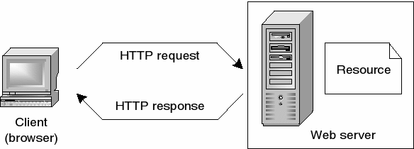
How does the web work?
Notes:
The web, or World Wide Web (WWW), is a system of interconnected documents and other resources, linked by hyperlinks and URLs. It allows users to access and share information using a web browser, such as Google Chrome, Firefox or Safari. When you type a URL, or web address, into your browser, it sends a request to a server. The server then sends back the requested information, which the browser displays in the form of a website. The website is made up of different types of files, such as HTML, CSS, and JavaScript, which work together to create the visual layout and interactive elements of the site. When you click on a link, it sends another request to the server for the new page or resource, and the process repeats. Web pages can also use other technologies like cookies and JavaScript to store information on your device and create a more personalized experience, like remembering your login info or shopping cart items on e-commerce website. Overall, the web is a vast network of interconnected documents and other resources that can be accessed by users through a web browser using a URL.

Slide 3
How to create a webpage?
Planning stage: Determine the purpose and goals of the website, create a content plan, and identify the target audience.
Design stage: Create a visual design, layout and wireframes for the website. This can include choosing colors, typography, and images that align with the overall aesthetic and goals of the website.
Frontend/Backend development: Write the code for the website using HTML, CSS, JavaScript and a programming language like Python or Ruby to create the frontend and backend logic.
Launch stage: Test the website for any bugs or errors, and make any necessary adjustments. Once the website is ready, it can be launched and made live for the public to access.

Slide 4
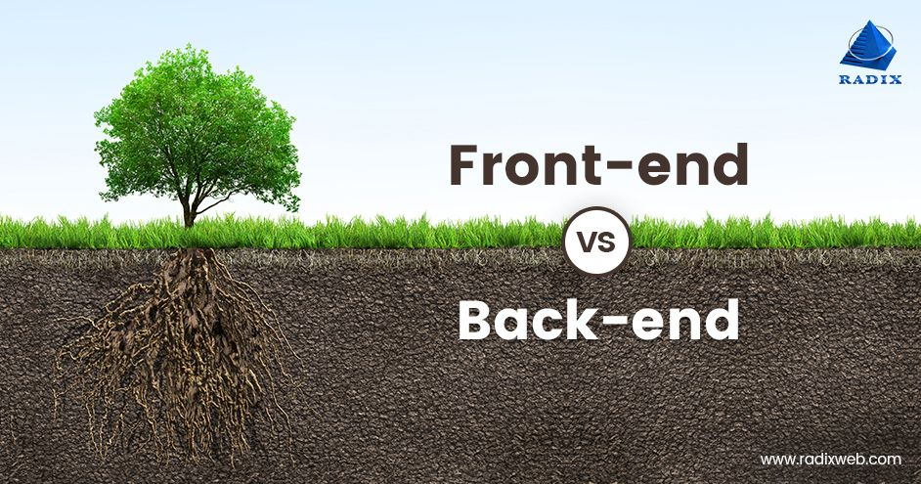
What is frontend?
Frontend refers to the part of web development that deals with the user interface and user experience of a website or application. It is the part of the website or application that the user interacts with and sees. It is typically made up of HTML, CSS, and JavaScript, which are used to create the layout, design, and interactivity of the website or application. Essentially, frontend is what the user sees, interacts and engage with on a website or application.

Slide 5

Frontend technologies
HTML (Hypertext Markup Language) is the standard language used to create web pages. It provides the structure and layout of a web page, including headings, paragraphs, images, and links.
CSS (Cascading Style Sheets) is used to add style and layout to web pages created with HTML. It allows for the separation of the presentation of a web page from its structure and content.
JavaScript is a programming language that is commonly used to create interactive and dynamic elements on web pages. It can be used to add interactivity and effects, such as animations, form validation, and dynamic content updates.
In summary, HTML provides the structure and content of a web page, CSS is used to add style and layout, and JavaScript adds interactivity and dynamic effects. Together, these three technologies are used to create the majority of websites on the internet.

Slide 6
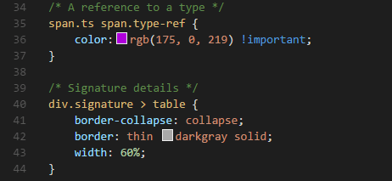
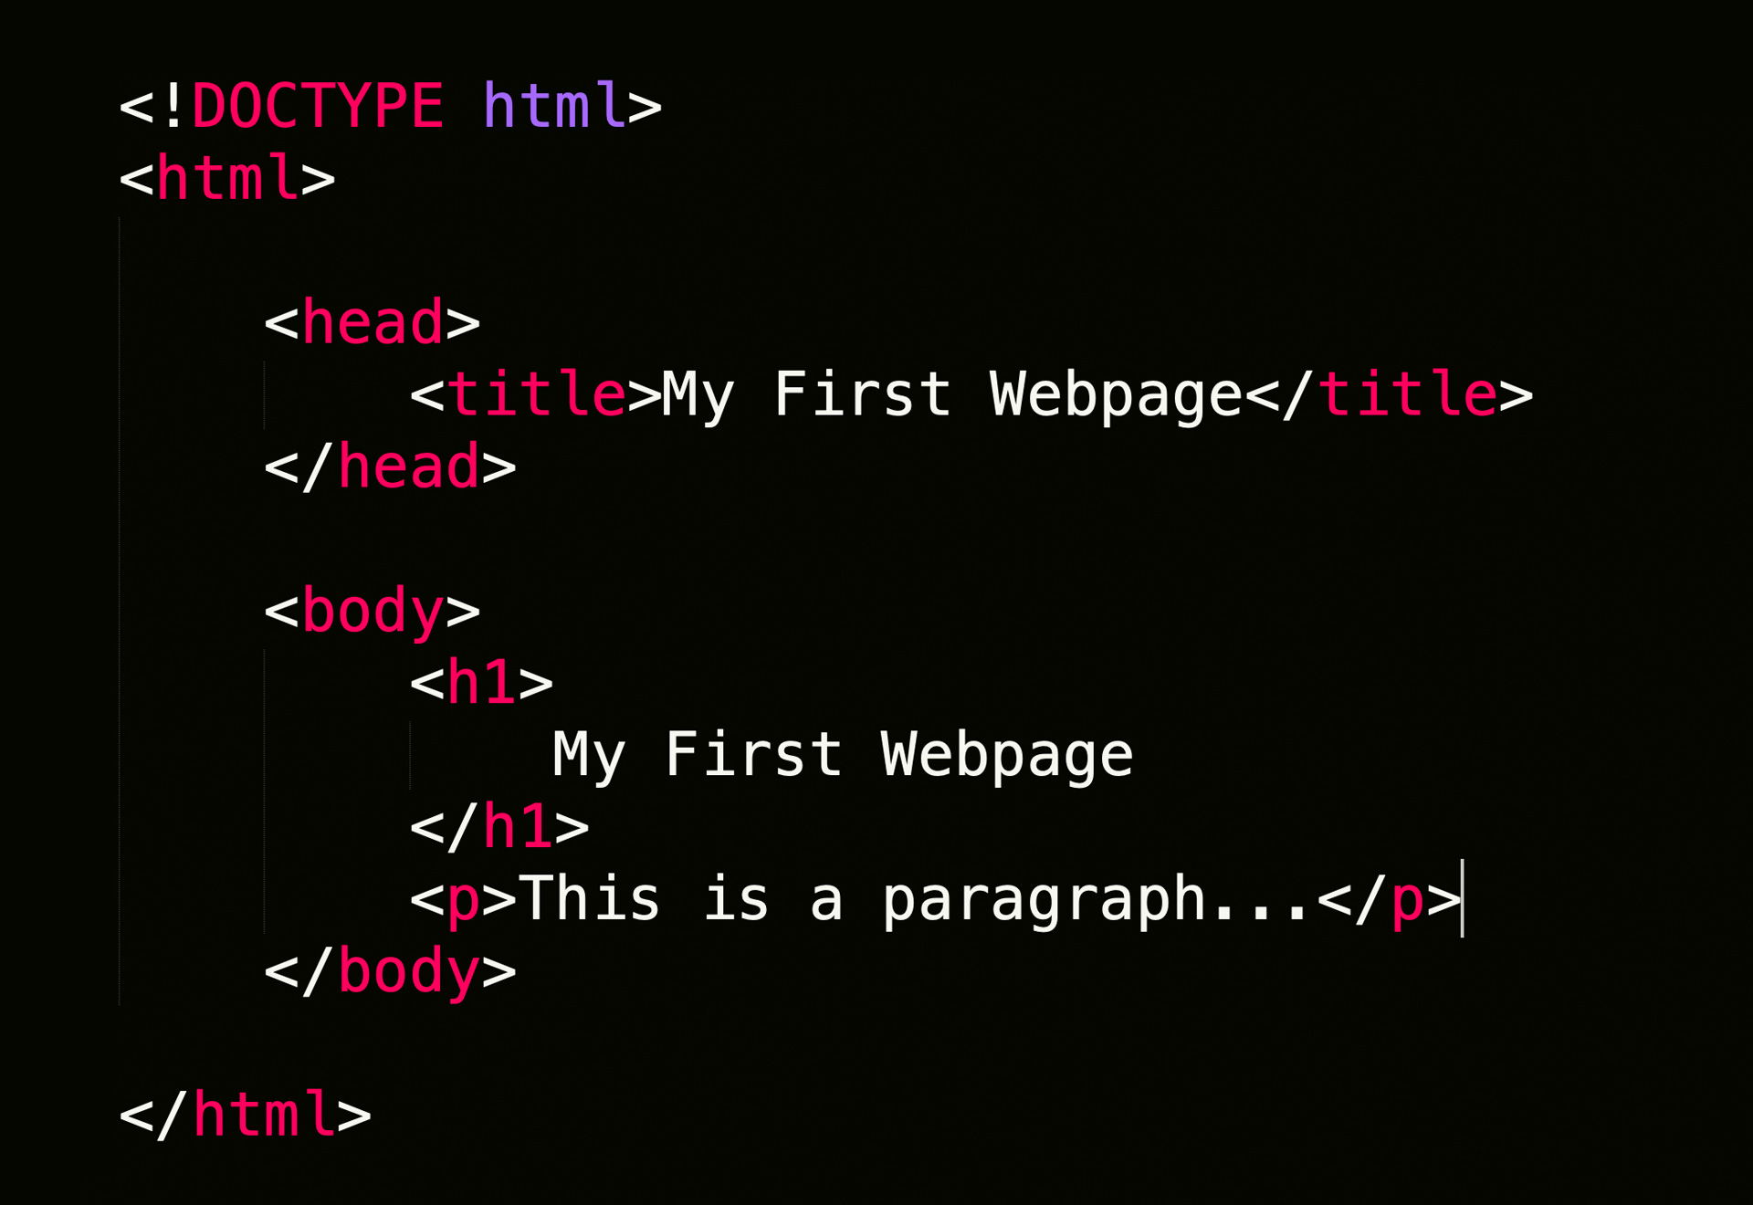
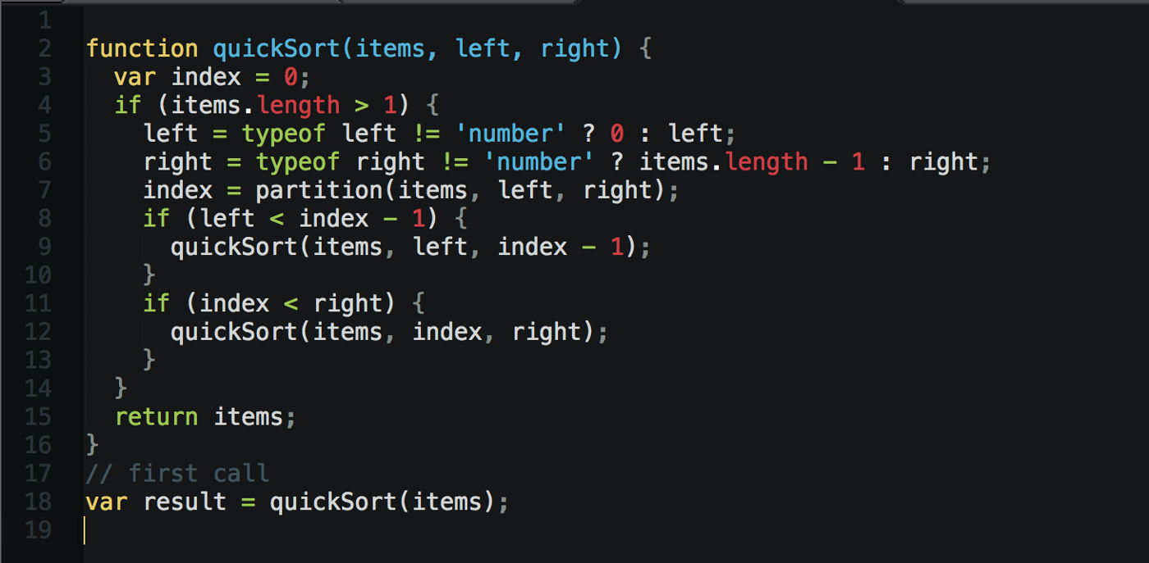
Syntax

Slide 7
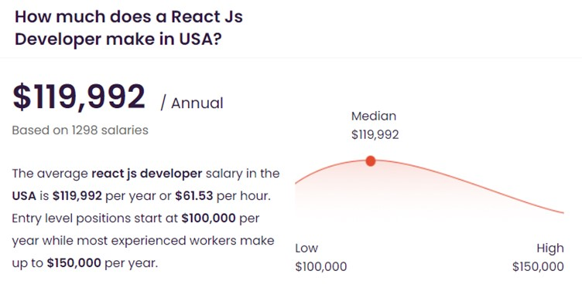
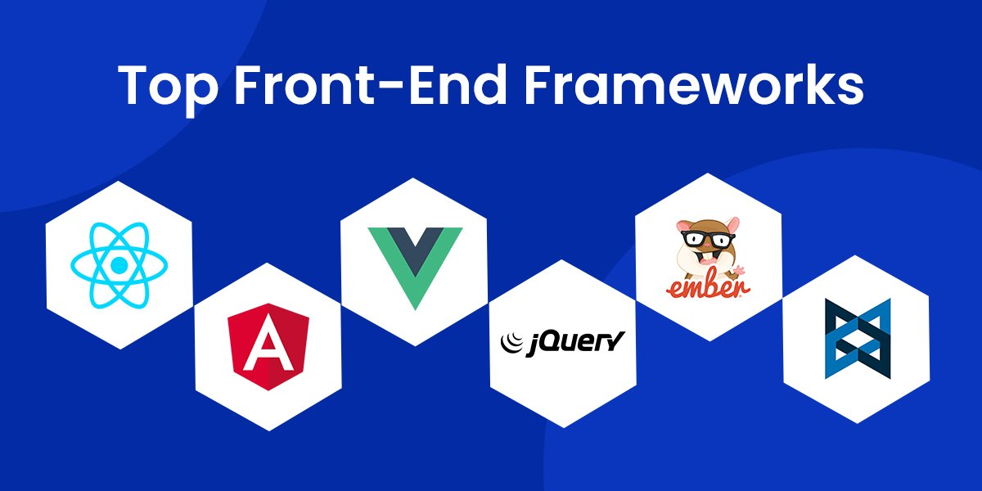
Frontend frameworks

Slide 8
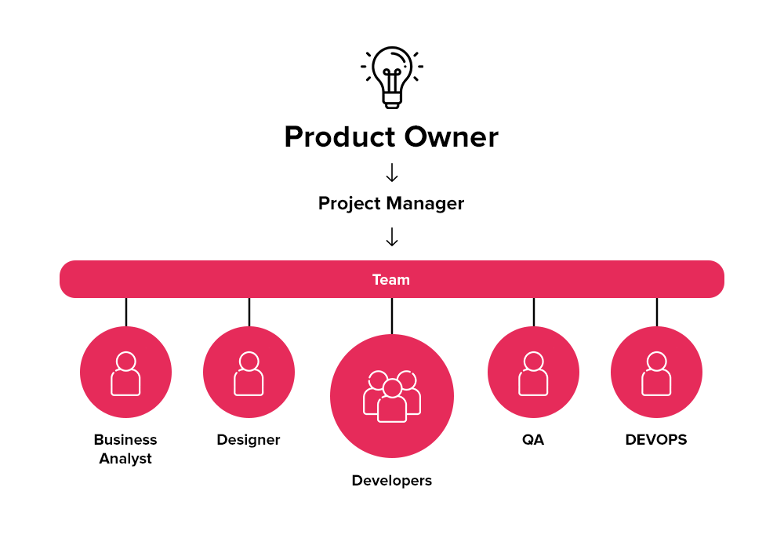
How does team look like?

Slide 9
Quiz
Question 1: What should you do during the planning stage of creating a website?
A) Write the code for the website
B) Determine the purpose and goals of the website
C) Launch the website
D) Choose colors and typography for the website

Slide 10
Quiz
Question 2: What programming languages can you use to create the frontend logic of a website?
A) HTML, CSS, and JavaScript
B) Python and Ruby
C) C++ and Java
D) PHP and SQL

Slide 11
Quiz
Question 3: What is HTML used for?
A) Adding style and layout to web pages
B) Creating interactive elements on web pages
C) Providing the structure and layout of a web page
D) None of the above

Slide 12
Quiz
Question 4: What is CSS used for?
A) Providing the structure and layout of a web page
B) Creating interactive elements on web pages
C) Adding style and layout to web pages created with HTML
D) None of the above

Slide 13
Quiz
Question 5: What is JavaScript used for?
A) Providing the structure and layout of a web page
B) Adding style and layout to web pages created with HTML
C) Creating interactive and dynamic elements on web pages
D) None of the above

Slide 14
Quiz
Question 6: What is the purpose of HTML, CSS, and JavaScript when used together?
A) To create the content of a website
B) To add interactivity and dynamic effects to a website
C) To add style and layout to a website
D) To create the majority of websites on the internet

Slide 15


How to start coding?
Install git
Windows
Mac (install from https://sourceforge.net/projects/git-osx-installer/, so you don't get to install it with xcode)
Install Visual Studio Code - link

Slide 16
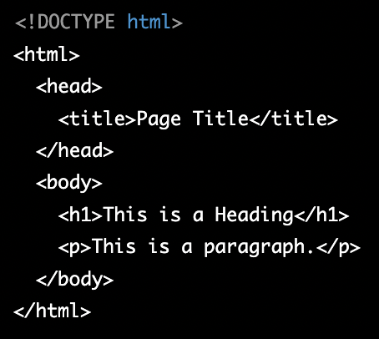
How to create HTML page
Open Visual Studio Code
Create empty index.html file
Start writing HTML code
Install Live Server extension (optional)
Open HTML file in browser:
Open HTML with live server
Or open file from file explorer

Slide 17
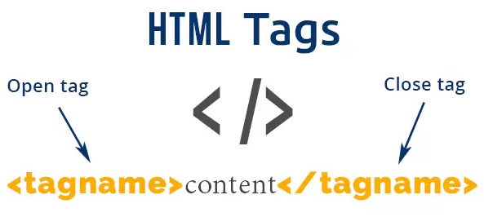
HTML tags
HTML tags are the building blocks of an HTML document. They are used to define the structure and content of a web page. There are many different types of HTML tags, but some common examples include:
<html>: This is the root element of an HTML document, and it contains all of the other elements on the page.
<head>: This element contains information about the document, such as the title of the page and any meta data.
<body>: This element contains the content of the page that is visible to the user.
<div>: This element is a container for other elements, and is often used to group elements together for styling purposes.
<p>: This element is used to define a paragraph of text.

Slide 18
HTML tags 2
<a>: This element creates a hyperlink to another web page.
<img>: This element is used to embed images in a web page.
<h1> - <h6>: These elements are used to define headings and subheadings on the page.
<ul> and <li>: These elements are used to create unordered lists.
<ol> and <li>: These elements are used to create ordered lists.
<form>: This element is used to create forms that allow users to input data and submit it to a server.
HTML tags are often paired, with a start tag and an end tag, and the content between the start and end tags is the content of the tag. For example, an <p> tag would be written as <p>This is a paragraph</p>, and the content inside the tags is "This is a paragraph"

Slide 19
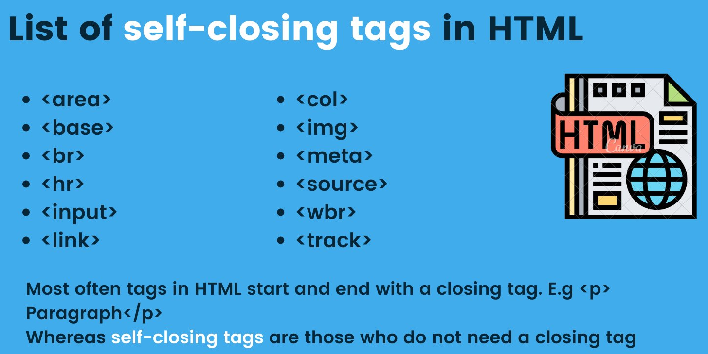
Self Closing Tags

Slide 20
Rest tags
https://www.w3schools.com/TAGS/default.asp

Slide 21
HTML attributes
Attributes are additional information that can be provided for HTML elements to modify their behavior or appearance. Attributes are added to an HTML element in the opening tag and are specified as a name-value pair, such as attribute="value". Some common uses of attributes include:
Specifying the source of an element's content:
Modifying the appearance of an element:

Slide 22
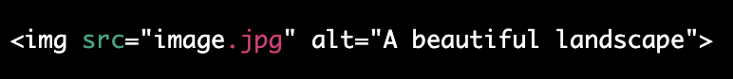
HTML attributes 2
3) Providing additional information about an element:
4) Creating links:
5) Specifying form controls:
https://www.w3schools.com/html/html_attributes.asp

Slide 23
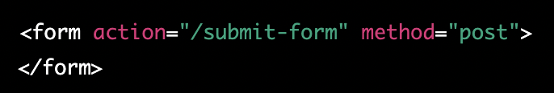
HTML forms
Forms are an essential part of many websites and web applications, allowing users to input data and interact with the site. To create a form in HTML, you can use several elements, including <form>, <input>, <select>, and <textarea>. Here is how you create sample form:
Use the <form> element to define the form. Add an action attribute to specify the URL where the form data will be sent and a method attribute to specify how the form data will be sent (usually "POST" or "GET").

Slide 24
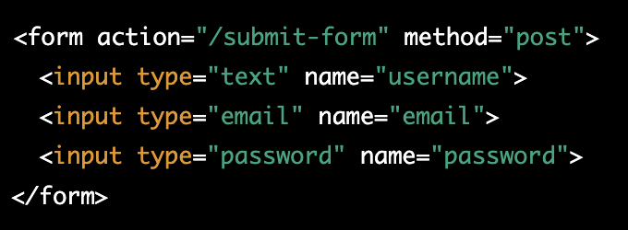
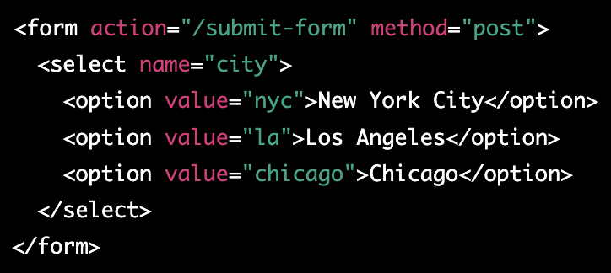
HTML forms 2
2) Use the <input> element to create form fields, such as text fields, checkboxes, and radio buttons. Add a type attribute to specify the type of input field, and a name attribute to identify the field.
3) Use the <select> element to create a drop-down list. Add options using <option> elements, and use the value attribute to specify the value that will be sent with the form.

Slide 25
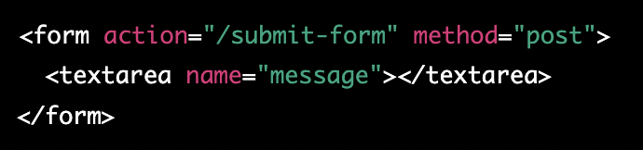
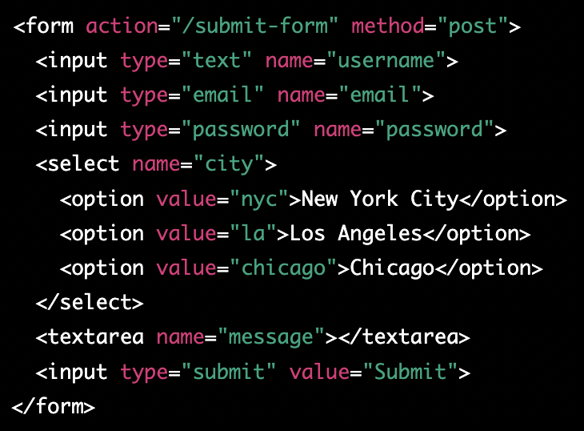
HTML forms 3
4) Use the <textarea> element to create a text area for users to enter a larger amount of text. Add a name attribute to identify the field.
5) Add a submit button to the form using an <input> element with a type attribute of "submit".

Slide 26
Homework
Create your own portfolio page with plain html
Include:
Header, that contains page navigation
Main section
Shortly about you
Work experience, education
Contact information
etc…
Portfolio ideas - https://bashooka.com/html/free-html-css-portfolio-web-design-templates/

